Slide 1

Overview and Data Science or Science of Data
Brian Wright, PhD
brianwright@virginia.edu
Assistant Professor
Data Science Institute

Slide 2
Outline
Class Administration and Connection to Capstones
Capstones Q & A
What is Data Science?

Slide 3
Class Administration/Tech Stack
Syllabus and files are on Github
https://github.com/NovaVolunteer/Practice_Application_DS
Use Collab for submission of graded material
Slack Channel:
Use for exchanging ideas, sharing interesting content or asking questions
Class is directly linked to your Capstone
Apply the content to development of the capstone project
Review Schedule and Requirements
Trello

Slide 4
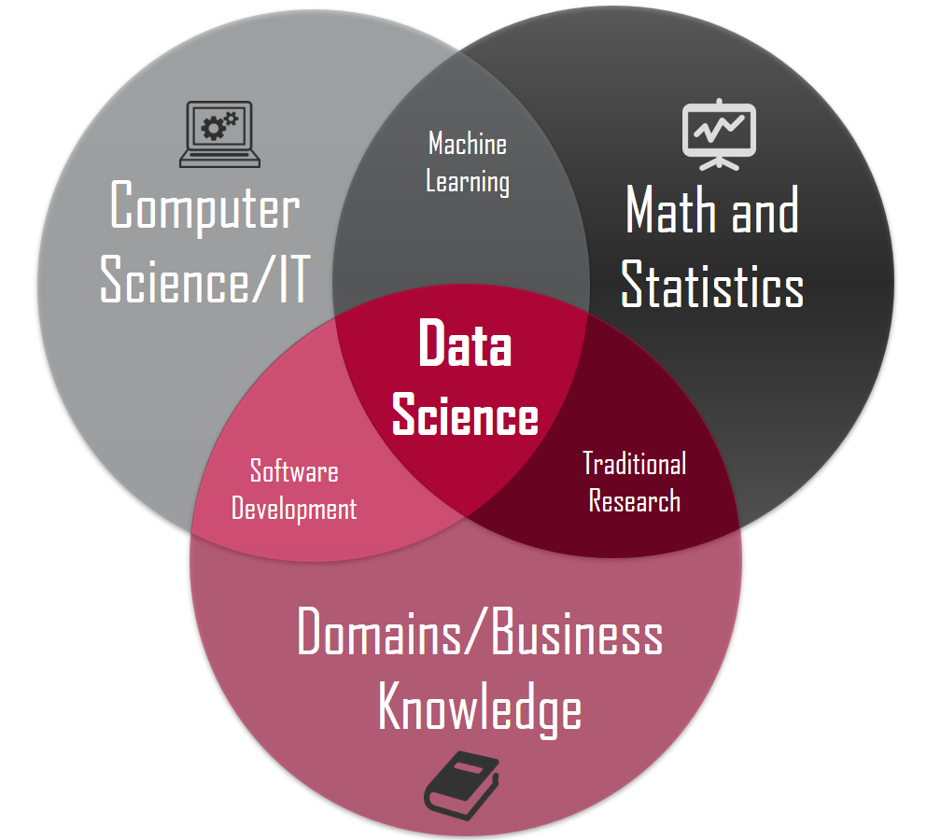
Data Science Overview
What is Data Science?
X
X
X
Source: https://honingds.com/blog/intro-to-data-science/

Slide 5
Data Science Overview
Why the surge in Data Science?
Increases in Computing Power - Processor Speed/Cloud Computing
Availability of Data – Storage Capacity
Open Source Tools – Incredibly dedicated and heavily vested communities supporting technology advancement

Slide 6
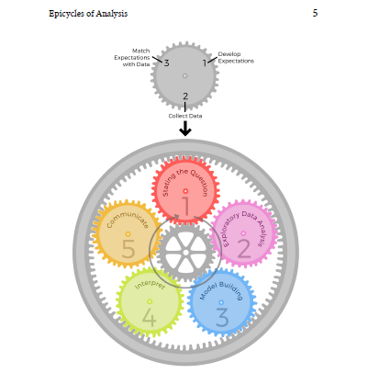
Data Science Overview
Roger Ping: Art of Data Science

Slide 7
7
6
2
5
3
4
http://sudeep.co/data-science/Understanding-the-Data-Science-Lifecycle/

Slide 8
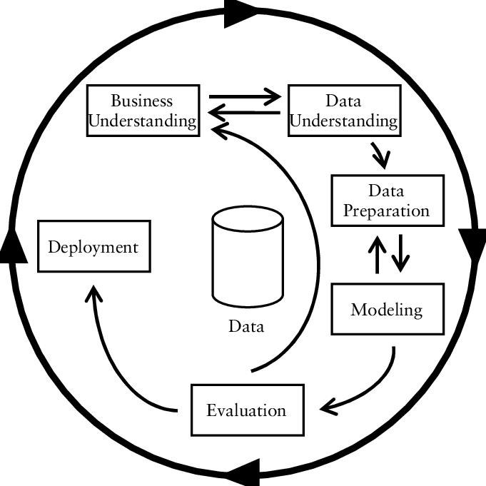
Data Science Overview
CRISP-DM
https://www.researchgate.net/figure/CRISP-DM-process-model_fig3_261307514

Slide 9
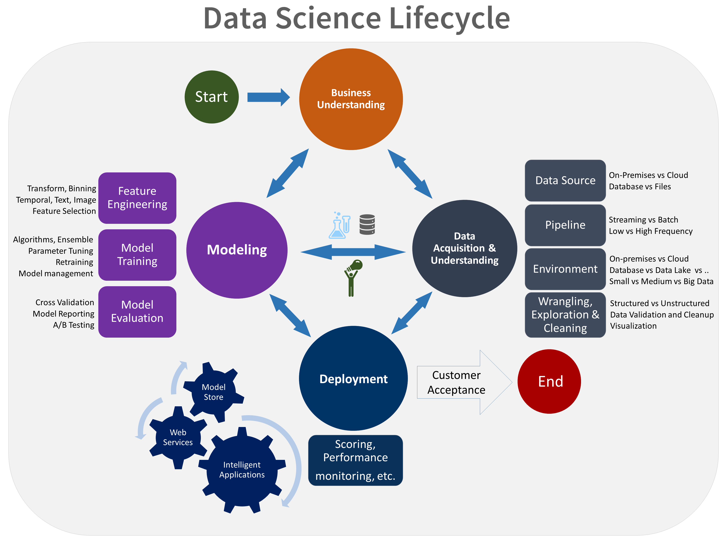
Microsoft
https://jenstirrup.com/2017/07/01/whats-wrong-with-crisp-dm-and-is-there-an-alternative/

Slide 10
Exercise: What you think? Get in Groups of Five What about these makes sense, what doesn’t and what would you draw…

Slide 11
LIFECYCLE OF THE CLASS
Question Development/Business Understanding
Project Charter
Project Proposal
Data Acquisition/Storage
Modelling Building
Data Exploration
Communications
Data Cleaning
Feature Engineering
Capstone Poster
Group Paper SEEDS
Group Presentations
Group Presentations
Final Presentations

Slide 12
Epicycle of Data Science
Setting Expectations,
Collecting information (data), comparing the data to your expectations, and if the expectations don’t match,
Revising your expectations or fixing the data so your data and your expectations match.

Slide 13
Data Science Overview
Match Expectations with Data
Develop Expectations
3
1
2
Can be the hardest, maybe not the most time consuming
Collect Data
Stating the Question

Slide 14
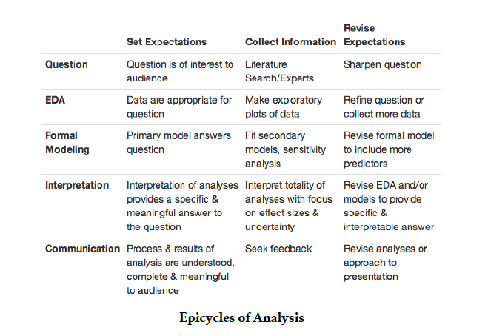
Epicycle at Each Stage

Slide 15
Research Practices Key to Question Definition/Expectations

Slide 16
Research Techniques
Create an informal Literature Review or business case review for the central topic of the issue being addressed
Subscribe to online journals or newsletters
Stay current with policy or regulatory changes in your field

Slide 17
Research Techniques
Have discussions with peers
Pull information from your previous work
Membership in professional groups
Attend conventions or training sessions

Slide 18
Research Techniques
Seek additional educational opportunities (brick and mortar or online)
Subscribe to subject specific listservs
Meet with a Librarian

Slide 19
Literature/Research Review
Gathering information on your question in a structured manner
Create an outline of sources
Reduce resources to key sources
Summarize the themes of these elements

Slide 20
Research Outcomes
Gives your recommendations and insight substance
Increases your value as a knowledge worker
Makes your organization more competitive from an intellectual capital standpoint
Allows for you to provide the maximum amount of value in your chosen field
Allows to become ever more specialized
Stay on top of the latest trends and insights
Creates a foundation for intuition and critical thinking in your chosen field

Slide 21
Lecture 2

Slide 22
Exercise
Get into your capstone groups
Discuss what you think the expectation are for your project and complete the following statement:
This will be a successful project if…

Slide 23
Landscape of Data Science

Slide 24
Types of Data Scientists
Those strong in statistics: they sometimes develop new statistical theories for big data, that even traditional statisticians are not aware of. They are expert in statistical modeling, experimental design, sampling, clustering, data reduction, confidence intervals, testing, modeling, predictive modeling and other related techniques.
Those strong in mathematics: NSA (national security agency) or defense/military people working on big data, astronomers, and operations research people doing analytic business optimization (inventory management and forecasting, pricing optimization, supply chain, quality control, yield optimization) as they collect, analyses and extract value out of data.
Those strong in data engineering, Hadoop, database/memory/file systems optimization and architecture, API's, Analytics as a Service, optimization of data flows, data plumbing.

Slide 25
Types of Data Scientists
Those strong in machine learning / computer science (algorithms, computational complexity)
Those strong in business, ROI optimization, decision sciences, involved in some of the tasks traditionally performed by business analysts in bigger companies (dashboards design, metric mix selection and metric definitions, ROI optimization, high-level database design)
Those strong in production code development, software engineering (they know a few programming languages)
Those strong in visualization
Those strong in GIS, spatial data, data modeled by graphs, graph databases
Those strong in a few of the above.

Slide 26
Fields of Focus
Biotech (Genome)
Finance (Sentiment)
Government (USGS.Defense.Energy)
Health Care (Survival Analysis/Fraud Detection)
Cyber Security (Defense Against Attacks)
Geospatial Analysis (Climate Change/Earthquakes/Intelligence)
What else?

Slide 27
As a result of the ever-expanding knowledge economy and emphasis on intellectual capital driving divisions of labor resulting in hyper specialization the need to establish high quality research habits is a critical step for anyone wanting to stay competitive in his/her chosen field.

Slide 28
Be thinking about what type of Data Scientists you are/or want to be and what field of specialty in which you would like to work

Slide 29
Data Science Overview
What do Data Scientists actually do anyway?
https://www.kaggle.com/surveys/2017

Slide 30
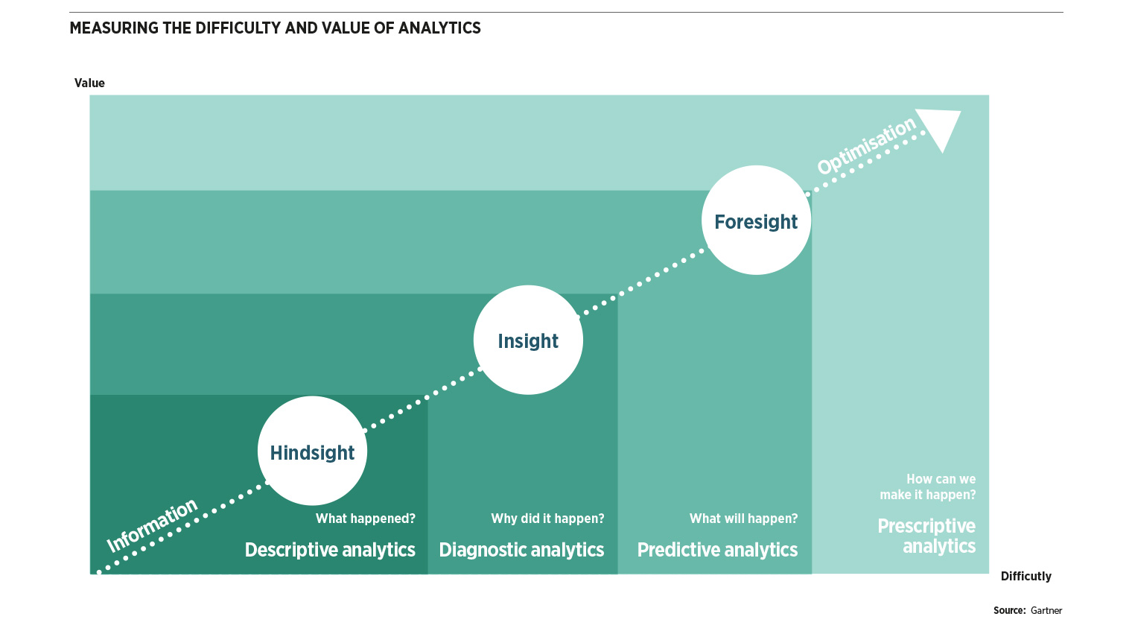
Data Science Overview: Data Analytics (Science) Levels
X
Cumulative Effect
X
Knowledge Requirement

Slide 31
Problem Solving and Teamwork

Slide 32
General Problem Solving Hints
There may be more than one right answer (or none at all)
There may be more than one path to the right answer
Use the right tool for the job
Use approximations
Don’t let yourself get stuck
Try thinking of something completely different

Slide 33
Specific Problem Solving Strategies
Draw a picture
Make a table
Graph the data
Re-organize the information
Solve a simplified version of the problem
Use logic or approximations to do a “gut-check” against your answers

Slide 34
The Four Questions Problem Solving
What do I know?
What am I looking for?
What else do I need to find it?
What do I expect?

Slide 35
Answer the Four Questions
American Pharaoh won the Triple Crown. He won the Belmont, a 12 furlong track, with a time of 2:26.65, the Kentucky Derby, a 10 furlong track, with a time of 2:03.02, and the Preakness Stakes, a 9.5 furlong track, with a time of 1.58.46. What was his average speed in mph?

Slide 36
Now Solve the Problem
Work in your Capstone Teams to code the solution with an output that reads “[Horse’s Name] averaged [ x ] mph across the three triple crown races.
American Pharaoh won the Triple Crown. He won the Belmont, a 12 furlong track, with a time of 2:26.65, the Kentucky Derby, a 10 furlong track, with a time of 2:03.02, and the Preakness Stakes, a 9.5 furlong track, with a time of 1.58.46. What was his average speed in mph?

Slide 37
Lecture 3
Data Resources: Jenn Huck
Contract Person: Claudia will tell me
Charter Overview

